Slide 1
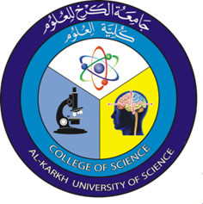

Cell Biology
Lab 1
Dr. Asmaa Sami Ibrahim /Ph.D. Cytogenetic and Biology of fish
And
Zanab Salim / MS.c. Plant tissue culture

Slide 2
The cell biology lab1
( The cell and cell differentiation )

Slide 3
Cell Definition:
-1The structural, functional and biological unit of all organisms.
2- An autonomous self-replicating unit that may exist as functional independent unit of life (as in the case of unicellular organism), or as sub-unit in a multicellular organism(such as in plants and animals) that is specialized into carrying out particular functions towards the cause of the organism as a whole.
3- A membrane bound structure containing biomolecules, such as nucleic acids, proteins, and polysaccharides

Slide 4
What is Cell Differentiation ?
- Cell differentiation is the most common process in all growing organisms, and it starts as soon as the female egg is fertilized.
- Sometimes, cell differentiation is also known to take place in reverse.
- Differentiated cells convert back to their original embryonic
- Our body consists of millions and millions of cells of different types. They are all formed from the genome of a single fertilized egg. The process by which a less specialized cell becomes a more specialized cell type is called cell differentiation.

Slide 5
- Differentiation is a common process in adult stem cells that divide and differentiate into specialized daughter cells.
- A cell that can differentiate into all types of cells that make up the body is known as totipotent cell. For mammals, totipotent includes the zygote and products - There are also certain types of cells that can differentiate into many types of cells. These cells are known as "pluripotent" or stem cells in animals (meristem cells in higher plants).
of the first few cell divisions.

Slide 6
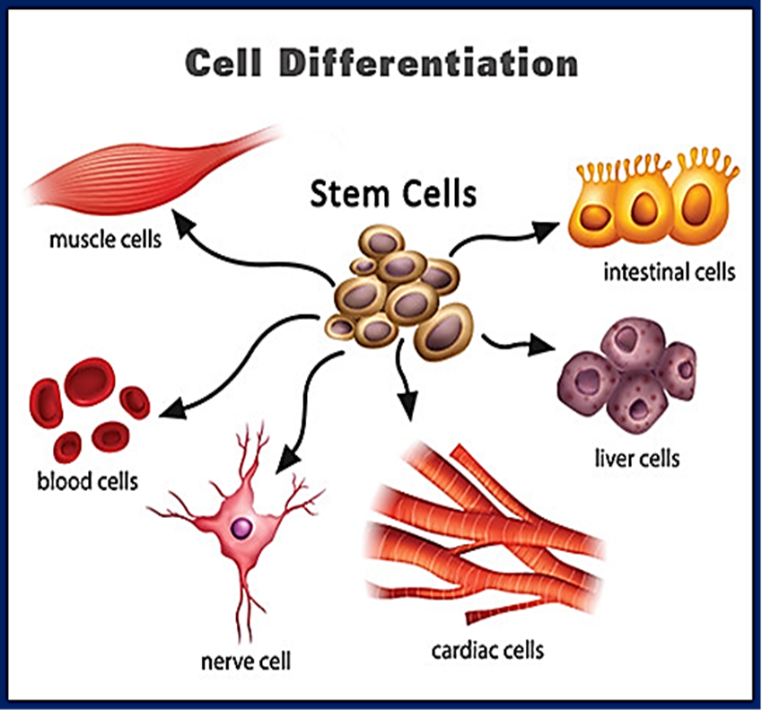

Slide 7
Examples of stem and progenitor cells include:
* Hematopoietic Stem Cells:
These are from the bone marrow and are involved in the production of red and white blood cells as well as the platelets.
* Epithelial Stem Cells:
These are progenitor cells and are involved in the production of certain skin cells.
* Muscle Satellite Cells:
These are progenitor cells that contribute to differentiated muscle tissue.

Slide 8
Why is Cell Differentiation Important?
We all know that it is a process in which cells become specialized in respective functions as well as structures. This is when the cells decide the type of cell they are going to be. It is especially important for the development of multicellular organisms. As mentioned above, we all begin with being a single-celled zygote, after which it is decided whether the cell is going to be muscle cell or a nerve cell, what structure it will take up, and what function it will perform

Slide 9
Factors Influencing Cell Differentiation:
* Gene Structure: This is the most important factor when it comes to cell differentiation. Each of the viable genes contains important information that determines the cell type and physical attributes of the animal (host). Any problem in the genetic material ultimately affects cell differentiation and the development of the host.

Slide 10
* Environmental Factors:
Various environmental factors as changes in temperature and supply of oxygen etc can affect the release and production of hormones given that various proteins are involved in the transmission of information as well as triggering of hormones. If these molecules are affected, then cell differentiation and development is also affected.

